Slide 1
SF
STARFORTH
A physics-driven adaptive runtime that is provably deterministic.
Technical elevator pitch · Robert A. James (“Captain Bob”) · Patent pending (USPTO provisional, Dec 2025)

Slide 2
THE TENSION
Adaptive systems drift. Deterministic systems can't tune.
Adaptive systems
Deterministic systems
Caches, JITs, browsers — they learn what's hot and speed it up. But internal decisions vary run to run: fine for a browser, disqualifying for anything that must be certified.
Same input, same output, every time — the property certification requires. But they can't adapt: no learning, no self-tuning, performance fixed at design time.
StarForth's claim: you don't have to choose.
StarForth — Technical Elevator Pitch
1

Slide 3
THE HEADLINE RESULT
Zero algorithmic variance, measured 90 times
0.00%
+25.4%
1.78×
coefficient of variation in cache decisions across 90 runs (F→∞, p < 10⁻³⁰)
throughput gain as the system self-tunes — no human in the loop (Cohen's d ≈ 5.08)
dictionary-lookup speedup from the hot-words cache (95% CI [1.75×, 1.81×])
Environmental noise (wall-clock timing) still varies 60–70% run to run — that's normal. The algorithm's own decisions never do. The two are statistically independent (r = 0.03, p = 0.87).
StarForth — Technical Elevator Pitch
2

Slide 4
HOW
Seven feedback loops, one conservation law
1
2
3
4
5
6
7
Execution Heat
Rolling Window
Linear Decay
Pipelining
Window Inference
Decay Inference
Adaptive Heartbeat
James Law: K ≡ 1.0
A single conservation invariant every VM in the fleet obeys — total normalized execution energy stays at unity, the way physics conserves energy. Not a convention the code follows; a constraint the runtime enforces at every heartbeat tick.
The 7 loops run in every VM; L8 “Jacquard” coordinates fleet-wide mode selection on top of them.
StarForth — Technical Elevator Pitch
3

Slide 5
ARCHITECTURE
One VM, one kernel, three cooperating roles
StarshipOS
The Tripod — multi-VM fleet
self-hosting OS — future
H
Hera
Governor — spawns, manages, reaps VMs. Never does work.
LithosAnanke v1.5.3
bare-metal UEFI kernel — M0–M7 done, M7.1 active
H
Hermes
Messenger — moves events between VMs. Never stores anything.
StarForth v3.1.0
FORTH-79 VM + physics-driven adaptive runtime
A
Artemis
Memory — owns block storage. Never routes anything.
Linux | amd64 / aarch64 / riscv64 bare metal
hosted or native
Dispatch is capability-based, always — never “send to the hottest VM.” Fleet K = Σ(all VM K values), conserved at all times.
StarForth — Technical Elevator Pitch
4

Slide 6
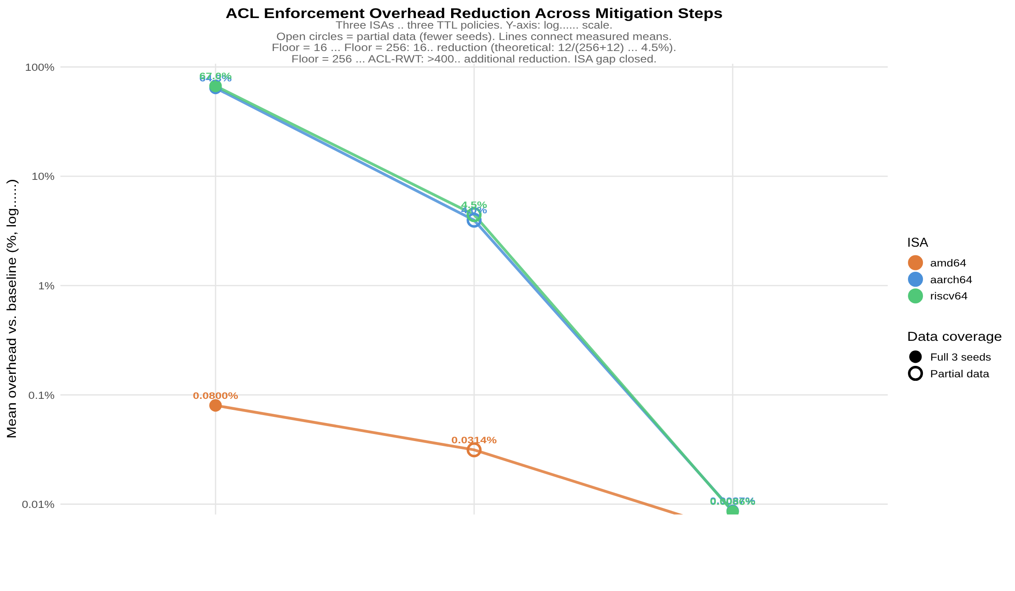
PROOF POINTS
Determinism holds under real measurement
Cross-ISA determinism
2,349,864 heartbeat ticks measured across amd64, aarch64, riscv64 under QEMU.
F ≈ 0, p = 1.000
execution-rate ANOVA across ISAs, CV = 0.000%
“The physics of the FORTH interpreter is a property of the algorithm, not the hardware.”
ACL security — 3 orders of magnitude
Word-level access control overhead, naive → compudynamic fix: ~65% → 0.0054–0.0088% on RISC ISAs.
StarForth — Technical Elevator Pitch
5

Slide 7
WHERE THIS STANDS
Built, measured, and moving toward self-hosting
Now
StarForth VM v3.1.0 — FORTH-79 compliant, 936+ tests, 453-word Mama dictionary. LithosAnanke kernel M0–M7 complete, M7.1 (Tripod fleet + ACL) active.
Next
ACL Phase 8 (Ed25519 PKI). Kernel block storage (M8–M9). Multi-VM fleet hardening.
Later
StarshipOS self-hosting. FPGA feasibility study for custom silicon.
Full roadmap: 2025 VM (done) → 2026 Kernel (in progress) → 2027 Self-hosting OS → 2028 FPGA feasibility.
StarForth — Technical Elevator Pitch
6

Slide 8
Let's talk.
Adaptive and deterministic, proven across 90 runs and three CPU architectures.
github.com/rajames440/StarForth · rajames440@gmail.com · Patent pending (USPTO provisional, Dec 2025)

