Slide 1
STARFORTH
A physics-inspired adaptive runtime with measured, zero-variance
algorithmic determinism
Robert A. James · Academic Overview · Patent pending (USPTO provisional, Dec 2025)

Slide 2
MOTIVATION
Adaptation and determinism are usually treated as a trade-off
Adaptive systems — inline caches, JIT compilers, browsers — improve performance by learning execution patterns at runtime. Their internal decisions vary run to run, which is unacceptable for systems requiring certification or formal verification.
Deterministic systems achieve certifiable, reproducible behavior but sacrifice runtime adaptation entirely — performance is fixed at design/compile time.
Research question: can a runtime system be simultaneously adaptive and exhibit zero variance in its own algorithmic decisions — independent of environmental noise?
StarForth — Academic Overview
1

Slide 3
POSITIONING
Where this sits relative to prior art
Approach | Speedup | Verifiable | Microkernel-safe | Complexity
Offline profiling | 1.05× | Yes | Yes | Medium
JIT compilation | 5–30× | No | No | High
StarForth (this work) | 1.78× | Yes | Yes | Low
Citation lineage: Hölzle/Chambers/Ungar (inline caches, PLDI 1991) · HotSpot tiered compilation · CompCert (Leroy, POPL 2006) · CakeML (ICFP 2014) · seL4 (SOSP 2009) · Ertl (stack caching, 1996).
Quotable framing: “the only implemented system combining real-time metrics collection, automatic threshold-based decisions, and verifiable arithmetic at VM scale.”
StarForth — Academic Overview
2

Slide 4
THE CORE CONTRIBUTION
James Law — a named conservation invariant
Implementation mechanism
K ≡ 1.0
• Discrete update: f[t+1] = f[t] + Δexec[t] − Δdecay[t], Δdecay[t] = λ·f[t]·Δt
The normalized total execution energy of the runtime is conserved at unity across every configuration and workload — enforced structurally, not asserted as a property that happens to hold.
• Continuous form: df/dt = r(t) − λf(t)
• Convergence metric: CV = σ/μ → 0
• Q48.16 fixed-point arithmetic throughout — eliminates IEEE-754 non-determinism across architectures
Fleet form: Fleet K = Σ(all VM K values), conserved across the multi-VM system at all times — a physics-style constraint, not a software convention.
Explicitly a modeling metaphor, not a claim of literal physical phenomena — the project's own ontology reserves “thermodynamically-inspired” as the sanctioned framing.
StarForth — Academic Overview
3

Slide 5
THE MECHANISM
Seven feedback loops + fleet-wide mode selection
1
Execution Heat
2
Rolling Window
Per-word frequency counter (hot-words cache)
Circular buffer of execution history
3
Linear Decay
4
Pipelining
Quiescent words lose heat over time
Word-to-word transition prediction
5
Window Inference
6
Decay Inference
Levene's test + binary chop for window width
Exponential regression for decay slope
7
Adaptive Heartbeat
Background tick coordinator
L8 Jacquard mode selector coordinates fleet-wide tuning across 6 modes (stable, volatile, diverse, temporal, transition, omni) based on attractor-bucket statistics — sits above, not inside, the 7 loops.
StarForth — Academic Overview
4

Slide 6
FORMAL VERIFICATION
Isabelle/HOL, not just empirical measurement
24
5
1
Isabelle/HOL theory files — one per feedback loop, plus word-category correctness and ACL invariants
ACL-specific proofs: Pin-Monotone, Inherit-Clears-Pin, TTL-Bounded, Emergency-Bypass, No-Escalation
explicit scope caveat: full mechanized proof of all 7 loops is not yet complete — partial proofs, stated openly
Build: isabelle build -D proof/ — covers loop correctness, arithmetic-word semantics, and the ACL access-control invariants alongside the empirical DoE campaigns below.
StarForth — Academic Overview
5

Slide 7
METHODOLOGY
Pre-registered, falsifiable, Design-of-Experiments
Formal claim table
5 primary claims (C1–C5) + 5 supporting (S1–S5), each with an explicit falsification threshold and reproduction command — not post-hoc narrative.
Null hypothesis framework
Every headline result is paired with the specific statistical test and threshold that would have disproven it.
Anti-claims table
A standing, explicit list of what is NOT claimed — see next slide.
Negative results catalogue
15 documented failure modes with root cause and scope boundary, published alongside the successes.
StarForth — Academic Overview
6

Slide 8
HEADLINE STATISTICAL RESULTS
90-run campaign (3 configurations × 30 runs)
Configuration | Early → Late | Change | Significance
C_NONE (baseline, loops off) | 10.76 → 11.45 ms | −6.4% | p > 0.10
C_CACHE (cache only) | 7.84 → 7.80 ms | +0.5% | p > 0.80
C_FULL (all 7 loops) | 10.20 → 7.61 ms | +25.4% | t=4.23, p=0.00012, d≈5.08
Variance decomposition: algorithmic CV = 0.00% vs. environmental (wall-clock) CV = 60–70%. Pearson r = 0.03, p = 0.87 — statistically independent. F-test F(29,29) → ∞, p < 10⁻³⁰. Statistical power at n=30 exceeds 0.99 (over-powered for the detection task).
StarForth — Academic Overview
7

Slide 9
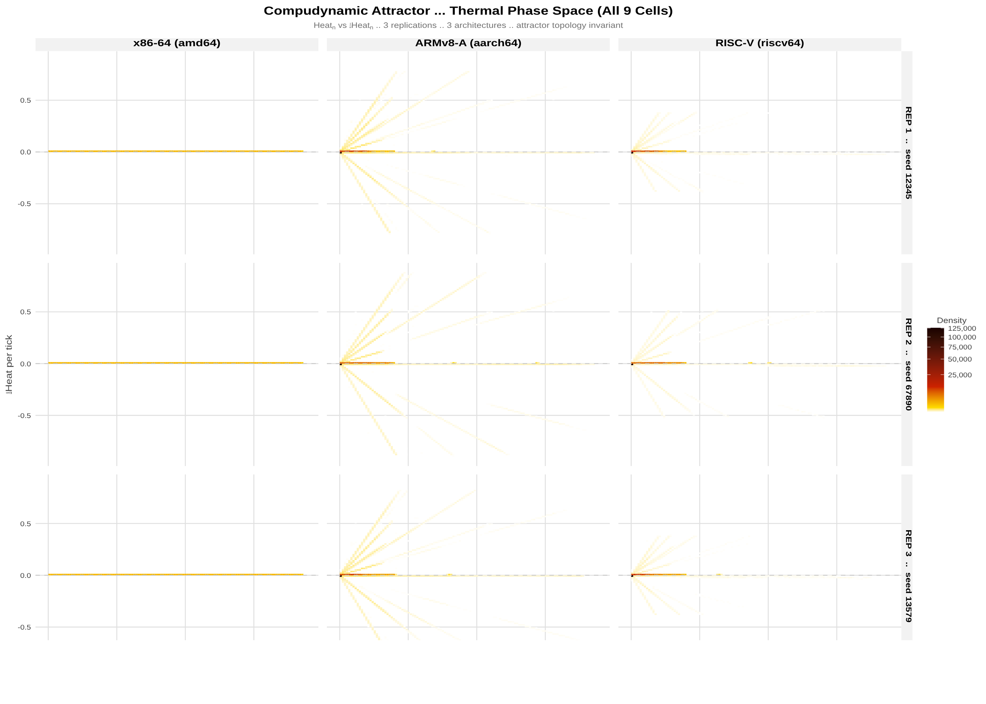
CROSS-ARCHITECTURE DETERMINISM
Bare-metal DoE: amd64, aarch64, riscv64
2,349,864 heartbeat ticks measured under QEMU across three CPU architectures (x86-64, ARMv8, RV64GC).
F ≈ 0, p = 1.000
execution-rate ANOVA across ISAs (F₂,₇₈₃₂₈₅)
CV = 0.000%
across all nine seed × ISA campaign cells
aarch64 and riscv64 produced byte-for-byte identical (MD5-matched) output on the original run. Chart: attractor structure by architecture — the same bounded region, every ISA.
StarForth — Academic Overview
8

Slide 10
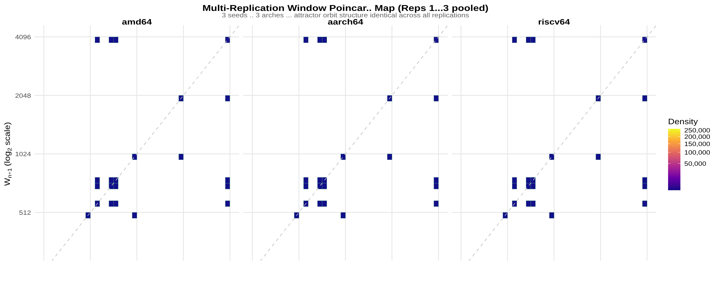
A DISCRETE ATTRACTOR, NOT NOISE
The “compudynamic breathing cycle”
StarForth — Academic Overview
9

Slide 11
SYSTEM ARCHITECTURE
VM, kernel, and multi-VM fleet
StarForth VM
FORTH-79 compliant, strict ANSI C99, 936+ tests, 453-word Mama dictionary at boot. Content-addressed (XXHash64) capsule initialization payloads.
LithosAnanke kernel
Bare-metal UEFI kernel, no libc. Boot milestones M0–M7: console → PMM → VMM → interrupts → timer → heap → VM bootstrap. M0–M5 complete/three-arch tested.
The Tripod
Hera (governor) / Hermes (messenger) / Artemis (memory) — capability-based dispatch only, never heat-based. Fleet K conserved across all three.
StarForth — Academic Overview
10

Slide 12
METHODOLOGICAL RIGOR
What this project explicitly does NOT claim
✕
Not a physical theory — thermodynamic language is an explicit modeling metaphor
✕
Not global optimality — locally adaptive, not provably optimal
✕
Not AI/ML — no neural networks, gradient descent, or training data of any kind
✕
Not the first adaptive VM, and not claimed to be the fastest
✕
Not complete formal verification — partial proofs, stated openly
✕
Not production-ready, and StarshipOS does not yet exist as a functional system
A standing anti-claims table, maintained alongside the results — uncommon rigor for a systems project, deliberately adopted here.
StarForth — Academic Overview
11

Slide 13
HONEST SCOPE
Where the results are validated — and where they aren't
Validated
Not yet validated
• CPU-bound, deterministic FORTH programs
• I/O-bound workloads
• Up to ~2.1M word executions
• Non-deterministic control flow
• Dictionaries up to ~500 entries
• Very short programs (< 1,000 iterations)
• amd64, aarch64, riscv64 (bare metal + hosted)
• Dictionaries > 100,000 entries (quadratic transition-matrix growth)
StarForth — Academic Overview
12

Slide 14
ROADMAP & OPEN QUESTIONS
Where this goes next
2025 VM (done) → 2026 Kernel + multi-VM fleet (in progress) → 2027 Self-hosting OS → 2028 FPGA feasibility
• Full mechanized proof coverage for all 7 feedback loops (currently partial)
• Extending validated scope to I/O-bound and non-deterministic-control-flow workloads
• Ed25519 PKI / thumbdrive challenge-response (ACL Phase 8 — the last open security milestone)
• Whether the conservation-law framing generalizes beyond FORTH-family interpreters
StarForth — Academic Overview
13

Slide 15
Discussion.
StarForth / LithosAnanke / StarshipOS — Robert A. James (“Captain Bob”)
github.com/rajames440/StarForth · rajames440@gmail.com
Patent pending — USPTO provisional, December 2025. Formal volumes, DoE reports, and Isabelle/HOL proofs available on request.

