Slide 1
STARFORTH
A Physics-Inspired Adaptive Runtime with Measured,
Zero-Variance Algorithmic Determinism
Full technical review · Robert A. James (“Captain Bob”)
Patent pending — USPTO provisional, December 2025. This session covers the full technical stack: formal model, VM physics, kernel, multi-VM fleet, security, and the bare-metal DoE campaign.

Slide 2
AGENDA
Seven parts, roughly in dependency order
I
Formal Foundations
The mathematical model and vocabulary everything else builds on
II
VM & Physics Runtime
The 7 feedback loops, and the 90-run determinism campaign
III
LithosAnanke Kernel
Bare-metal boot, memory layout, the capsule system
IV
The Tripod
Hera / Hermes / Artemis — the multi-VM fleet and its conservation law
V
Word-Level ACL
Access control, and the campaign that found and fixed a 65% regression
VI
Cross-ISA DoE
The bare-metal determinism campaign across three CPU architectures
VII
Verification & Rigor
Isabelle/HOL proofs, negative results, and honest scope
StarForth — Technical Deep Dive
1

Slide 3
I
Formal Foundations
The mathematical model and vocabulary everything else builds on
StarForth — Technical Deep Dive
2

Slide 4
MOTIVATION
Why adaptation and determinism are usually incompatible
Adaptive systems (inline caches, JIT compilers, browsers) improve performance by learning execution patterns at runtime — but their internal decisions vary run to run, driven by timing-sensitive heuristics. That variance is disqualifying for systems requiring certification: medical devices, flight control, financial infrastructure.
Deterministic systems achieve certifiable reproducibility by fixing behavior at design time — sacrificing runtime adaptation entirely. The literature largely treats this as an inherent trade-off (see Related Work, academic overview deck).
Central claim: an adaptive VM can achieve 0.00% algorithmic variance across 90 experimental runs. Adaptation and determinism are not mutually exclusive.
StarForth — Technical Deep Dive
3

Slide 5
FORMAL MODEL I
Execution frequency as a discrete-time dynamical system
Discrete-time update
f[t+1] = f[t] + Δexec[t] − Δdecay[t]
Δdecay[t] = λ · f[t] · Δt
Continuous-time form
df/dt = r(t) − λf(t)
f(t) = e^(−λt) · [f₀ + ∫₀ᵗ r(τ)e^(λτ) dτ]
λ = decay coefficient · f = per-word execution frequency (heat) · r(t) = execution rate at time t. All arithmetic is Q48.16 fixed-point — no IEEE-754 involved anywhere in the loop.
StarForth — Technical Deep Dive
4

Slide 6
FORMAL MODEL II
Cache membership, window inference, decay inference
Hot-words cache membership
e ∈ Cache ⟺ rank(e) ≤ K, rank(e) = |{e′ : f(e′) > f(e)}| + 1
Window-width inference (Loop #5)
w* = argmin{Var(w) : w ∈ [w_min, w_current]}, subject to Levene's-test p < α (0.05)
Decay-slope inference (Loop #6)
log-linearized least squares on ln(f) = ln(f₀) − λt
Transition probability (Loop #4)
P(B|A) = count(A→B) / count(A), MLE, stored Q48.16
Convergence metric
CV = σ/μ → 0
StarForth — Technical Deep Dive
5

Slide 7
LEXICON (1/2)
The thermodynamic-metaphor vocabulary, formally defined
Term | Meaning
Execution Heat | Per-word frequency counter; increments on execution, decays over time
Hot-Words Cache | Fixed-size cache of the K highest-heat dictionary entries
Decay Coefficient (λ) | Rate constant governing exponential heat decay
Rolling Window of Truth | Circular buffer holding recent execution history
Attractor | A recurring, bounded state-space region the system settles into
Steady-State Equilibrium | The point where heat gain and decay balance
StarForth — Technical Deep Dive
6

Slide 8
LEXICON (2/2)
Continued
Term | Meaning
Word Transition | An observed A→B execution pair, used for pipelining prediction
Deterministic Convergence | The property that repeated runs reach the same cache configuration
Variance Inflection Point | The tick at which CV crosses a stability threshold
Levene's Test | Statistical test for equality of variances, used in window inference
Phase Space | The (heat, Δheat) coordinate space used for thermal portraits
Adaptive Heartbeat | The background tick coordinator driving all 7 loops
Full lexicon with formal/measurement/category triples: ONTOLOGY.md §III (15 terms).
StarForth — Technical Deep Dive
7

Slide 9
II
VM & Physics Runtime
The 7 feedback loops, and the 90-run determinism campaign
StarForth — Technical Deep Dive
8

Slide 10
FEEDBACK LOOPS (1–4)
Per-word heat tracking and prediction
1
Execution Heat
dictionary_heat_optimization.c — frequency counter per word, the substrate every other loop reads.
2
Rolling Window of Truth
rolling_window_of_truth.c — double-buffered circular buffer of execution history, adaptive sizing.
3
Linear Decay
Quiescent words lose heat linearly per tick; tick-based (not wall-clock-based) as of this session's own fix.
4
Pipelining
physics_pipelining_metrics.c — word-to-word transition prediction, speculative execution via MLE transition probabilities.
StarForth — Technical Deep Dive
9

Slide 11
FEEDBACK LOOPS (5–7) + L8 JACQUARD
Meta-inference and fleet-wide coordination
5
Window Width Inference
inference_engine.c — Levene's test + binary chop, asks “is the current window well-matched to observed dynamics,” not “what is the true curve.”
6
Decay Slope Inference
inference_engine.c — exponential regression recovers λ from observed heat trajectories.
7
Adaptive Heartbeat
Background tick coordinator (HeartbeatState) driving all six other loops on a shared cadence.
L8 Jacquard Mode Selector — ssm_jacquard.c. A steady-state machine layered above the 7 loops, switching between 6 named modes (stable, volatile, diverse, temporal, transition, omni) based on attractor-bucket statistics. Controlled by vm->ssm_l8_state.
StarForth — Technical Deep Dive
10

Slide 12
DICTIONARY-LOOKUP MICRO-BENCHMARK
100,000-sample study of the hot-words cache
Path | Hits | Mean latency | Min | Max
Cache | 35,640 (35.64%) | 31.543 ns | 22.0 ns | 101.0 ns
Bucket | 46,880 (46.88%) | 56.237 ns | 23.0 ns | 370.0 ns
Miss | 17,480 (17.48%) | — | — | —
1.78×
99.9%
<0.1%
speedup (56.237 / 31.543 ns), 95% CI [1.75×, 1.81×], 99% CI [1.73×, 1.83×]
P(speedup > 1.1×) — Bayesian Beta-Binomial posterior
reproducibility stdev across 3 runs (1.7820× / 1.7790× / 1.7810×)
10 of 32 cache slots (31%) auto-promoted; hottest words followed a Zipfian distribution (EXIT: 114, LIT: 101). Overhead: 256B cache array + ~4.8KB per-word metadata, <0.09% of the 5MB VM address space, ~2 CPU cycles/lookup.
StarForth — Technical Deep Dive
11

Slide 13
THE 90-RUN DETERMINISM CAMPAIGN
3 configurations × 30 runs each
Config | Early → Late | Change | Test statistic
C_NONE (all loops off) | 10.76 → 11.45 ms | −6.4% | p > 0.10
C_CACHE (cache only, no inference) | 7.84 → 7.80 ms | +0.5% | p > 0.80
C_FULL (all 7 loops active) | 10.20 → 7.61 ms | +25.4% | t=4.23, df=28, p=0.00012
Cohen's d ≈ 5.08 for C_FULL's improvement — an unusually large effect size, consistent with a structural (not incidental) mechanism.
Determinism significance
F(29,29) → ∞, p < 10⁻³⁰ · Bayesian posterior P(H₁|data) ≈ 1 − 10⁻³⁰ (agnostic prior, likelihood ratio ≈ 10³⁰) · Statistical power at n=30, δ=0.1, σ=0.05, α=0.05: power > 0.99 — over-powered for the detection task, a methodological strength worth naming explicitly.
StarForth — Technical Deep Dive
12

Slide 14
VARIANCE DECOMPOSITION
Separating algorithm from environment
Algorithmic variance
Environmental variance
0.00%
60–70%
Cache-decision CV across 90 runs — the system's own choices, measured directly.
Wall-clock timing CV over the same runs — CPU scheduling, thermal, other processes.
The two are statistically independent: Pearson r = 0.03, p = 0.87. Levene's test W = 0.00, p < 10⁻²⁰. This is the empirical core of the “adaptive and deterministic” claim: the algorithm's choices and the machine's noisy execution of them are decoupled.
StarForth — Technical Deep Dive
13

Slide 15
III
LithosAnanke Kernel
Bare-metal boot, memory layout, the capsule system
StarForth — Technical Deep Dive
14

Slide 16
BOOT SEQUENCE
M0–M7, UEFI firmware to FORTH REPL
✓
M1
Console
UART 16550 + framebuffer VT100
✓
M2
PMM
Physical memory manager (bitmap)
✓
M3
VMM
4-level x86_64 paging
✓
M4
Interrupts
IDT + APIC
✓
M5
Timer
TSC + HPET + APIC, 100Hz heartbeat
✓
M6
Heap
16MB kmalloc — present, full validation deferred
…
M7
VM Bootstrap
Capsule loading → Tripod fleet → ACL → ok> REPL
M0–M5 complete, verified via QEMU/OVMF, three-arch tested. M7.1 (current frontier): capsule birth protocol, Tripod multi-VM fleet, word-level ACL.
StarForth — Technical Deep Dive
15

Slide 17
MEMORY LAYOUT & CAPSULE SYSTEM
Content-addressed, immutable initialization payloads
Kernel memory layout
Capsule birth protocol
• 16MB kernel heap (kmalloc)
1. Locate capsule by name
• Block RAM: LBN 0–991 (1MB dedicated)
2. Validate XXHash64 content hash
• Kernel ramdrive: LBN 2048–3071 (1MB)
3. Allocate VM ID
4. Execute IDENTITY (capsule code)
• LBN 2048 = init.4th entry point
5. Execute PERSONALITY (block 1, ramdrive)
• Hosted VM: 5MB total, dictionary = first 2MB
6. Log parity record (VM ID + hash + dict hash)
Capsule taxonomy: (m) MAMA_INIT — exactly one · (p) PRODUCTION — truth-bearing baby-VM initializers · (e) EXPERIMENT — DoE workload-only. Content-addressed via XXHash64: any mutation is detectable by construction.
StarForth — Technical Deep Dive
16

Slide 18
IV
The Tripod
Hera / Hermes / Artemis — the multi-VM fleet and its conservation law
StarForth — Technical Deep Dive
17

Slide 19
THREE ROLES, NO OVERLAP
Capability-based dispatch, always
H
Hera — VM-HERA=0
Governor. Spawns, manages, reaps VMs. Does not do work.
H
Hermes — VM-HERMES=1
Messenger. Moves events between VMs. Does not store anything.
A
Artemis — VM-ARTEMIS=2
Memory. Owns block storage/persistence. Does not route anything.
“If you find yourself putting event dispatch logic in Artemis, or storage logic in Hermes, or work execution logic in Hera — stop. You have the wrong VM.”
Dispatch is capability-based on work type — Block I/O → Artemis, Event emit/drain → Hermes, VM lifecycle → Hera. There is no routing algorithm, and never “send to the hottest VM.”
StarForth — Technical Deep Dive
18

Slide 20
HERMES — MESSENGER DETAIL
Point-to-point messages, PubSub channels
Message node — 8 cells
Channels — 6-cell node
type · sender · recipient · payload · heat (Q48.16) · sequence · channel-ptr · reserved
One permanent COMMON channel (negotiation only). Ephemeral channels: born hot, reaped cold, owner = always the responder. Negotiation: request on COMMON → accept → owner creates channel → business conducted → owner reaps.
Compudynamic lifecycle: born hot (full heat) → cools each heartbeat tick → ACK = clean death, K redistributed → NACK = requeue, reduced heat → TTL expiry = reaped, K rebalanced.
Terminology note: reaping is heat-gated reclamation, not mark-and-sweep — objects free only when heat decays to zero, serialized against traffic on that object only, not stop-the-world. GC vocabulary is explicitly rejected as carrying the wrong expectations.
StarForth — Technical Deep Dive
19

Slide 21
ARTEMIS — MEMORY DETAIL
Two-BAM design over block-addressed storage
 | Physical BAM | Logical BAM
Cells/entry | 2 | 4
Fields | LBN, free flag | LBN, heat (Q48.16), XXHash64 identity, flags
Role | Raw substrate — free/not-free only | Content-addressing, ACL records, cold capsule storage
Three planned thermal zones
• Zone 0 — Block RAM, LBN 0–991 (fastest, always present, K-floor)
• Zone 1 — Ramdrive, LBN 2048–3071 (RAM-backed, block-subsystem path)
• Zone 2 — External device (dynamic, event-driven presence)
Currently authorized scope is narrower: a single 30MB flat pool, no zones yet — the zone/migration design exists but is explicitly marked Future Material, not build-authorized without the project lead reopening it.
StarForth — Technical Deep Dive
20

Slide 22
THE FLEET INVARIANT
K conservation across the whole Tripod
Fleet K = Σ (all VM K values) ≡ 1.0
Conserved across all three VMs at all times — a physics-style constraint enforced by the runtime, not a convention that happens to be followed. Each VM runs its own compudynamic engine internally and autonomously; no VM manages another's heartbeat.
Two roles for compudynamics — do not conflate them
Role 1 — Intra-VM physics engine: drives each VM's own adaptive heartbeat (the 7 loops + K arithmetic), fully autonomous.
Role 2 — Hera's VM-lifecycle driver: Hera observes the fleet-K picture to decide health/starvation/spawn/reap. This is lifecycle telemetry, never a dispatch mechanism — Hera does not use fleet K to route work.
StarForth — Technical Deep Dive
21

Slide 23
V
Word-Level ACL
Access control, and the campaign that found and fixed a 65% regression
StarForth — Technical Deep Dive
22

Slide 24
ACL ARCHITECTURE
Policy lives in FORTH, not C
Every dictionary entry carries four access-control fields, checked by a C interpreter hook but governed entirely by FORTH policy in ACL.4th — zero policy logic in C.
Field | Purpose
acl_ttl | Time-to-live for the word's access grant
acl_allow | Allow/deny bitmask
acl_mode | STRICT / TTL / PINNED
acl_pinned | One-way pin — inheritance clears it, copies mode
Two console layers
ok> — emergency console (fault-handler bypass, bare REPL only)
zuse)ok> — superuser session, fully subject to ACL
Status: Phases 1–7 of 8 complete (C infrastructure, FORTH policy layer, zuse bootstrap superuser, Isabelle proof stubs, kernel parity). Phase 8 — Ed25519 PKI / thumbdrive challenge-response — is the only remaining milestone.
StarForth — Technical Deep Dive
23

Slide 25
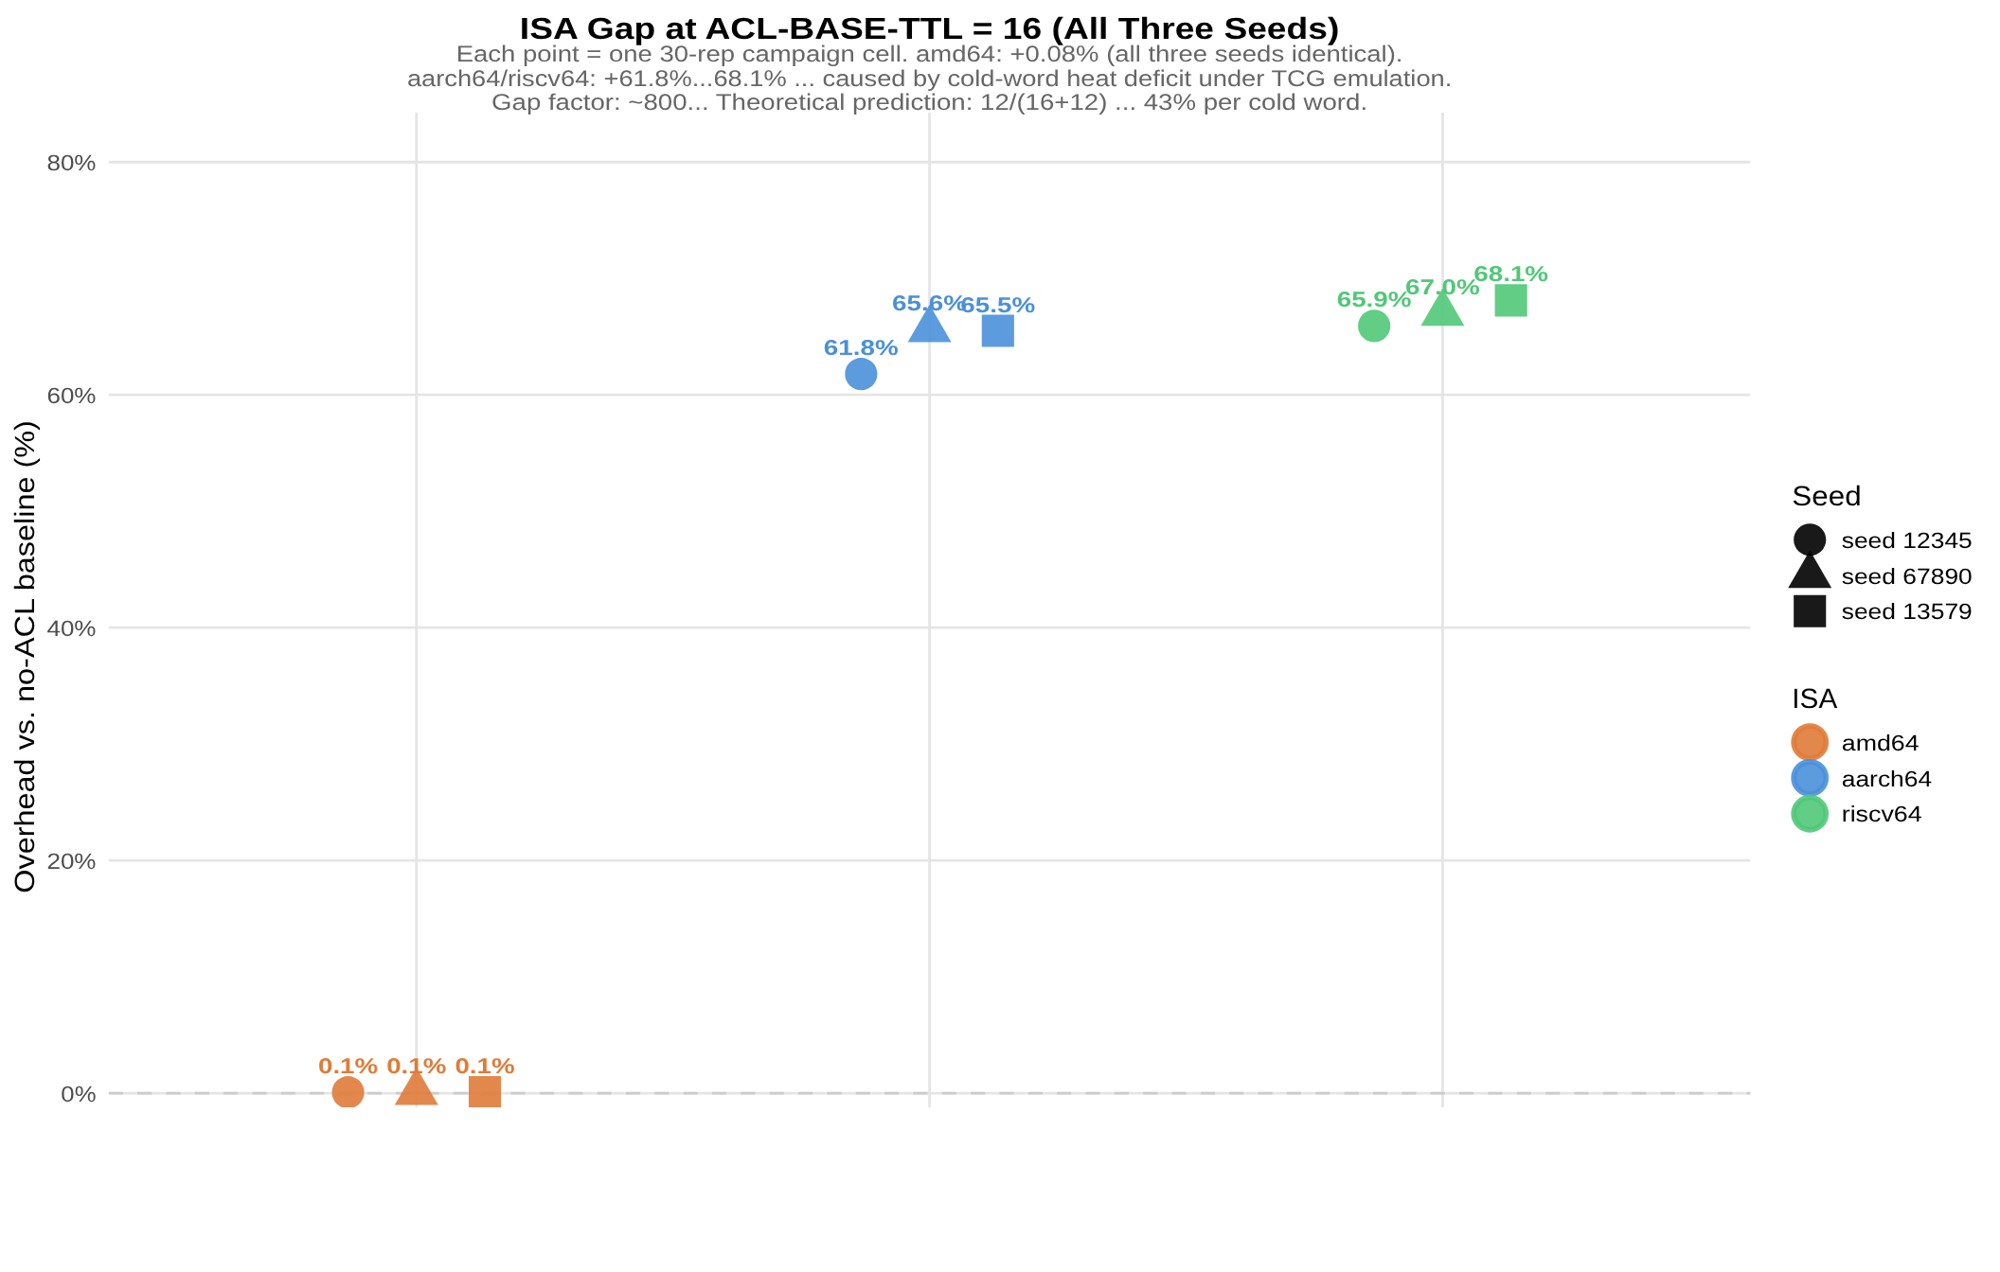
THE ISA GAP
A naive TTL floor cost 65% on RISC architectures
ISA | Overhead (Floor=16)
amd64 | +0.080% (3 seeds identical)
aarch64 | +61.8% to +65.6%
riscv64 | +65.9% to +68.1%
Root cause: amd64 runs ~5× faster under TCG emulation, so the same workload leaves words “cold” on RISC targets — never crossing the TTL floor, forcing repeated cold-path rechecks. Model: overhead(F) ≈ 12/(F+12), giving 43% at F=16.
Raising the floor to 256 cut RISC overhead 16× (to +3.96%/+4.45%) — better, but still non-trivial. This motivated a structural fix, not a bigger constant.
StarForth — Technical Deep Dive
24

Slide 26
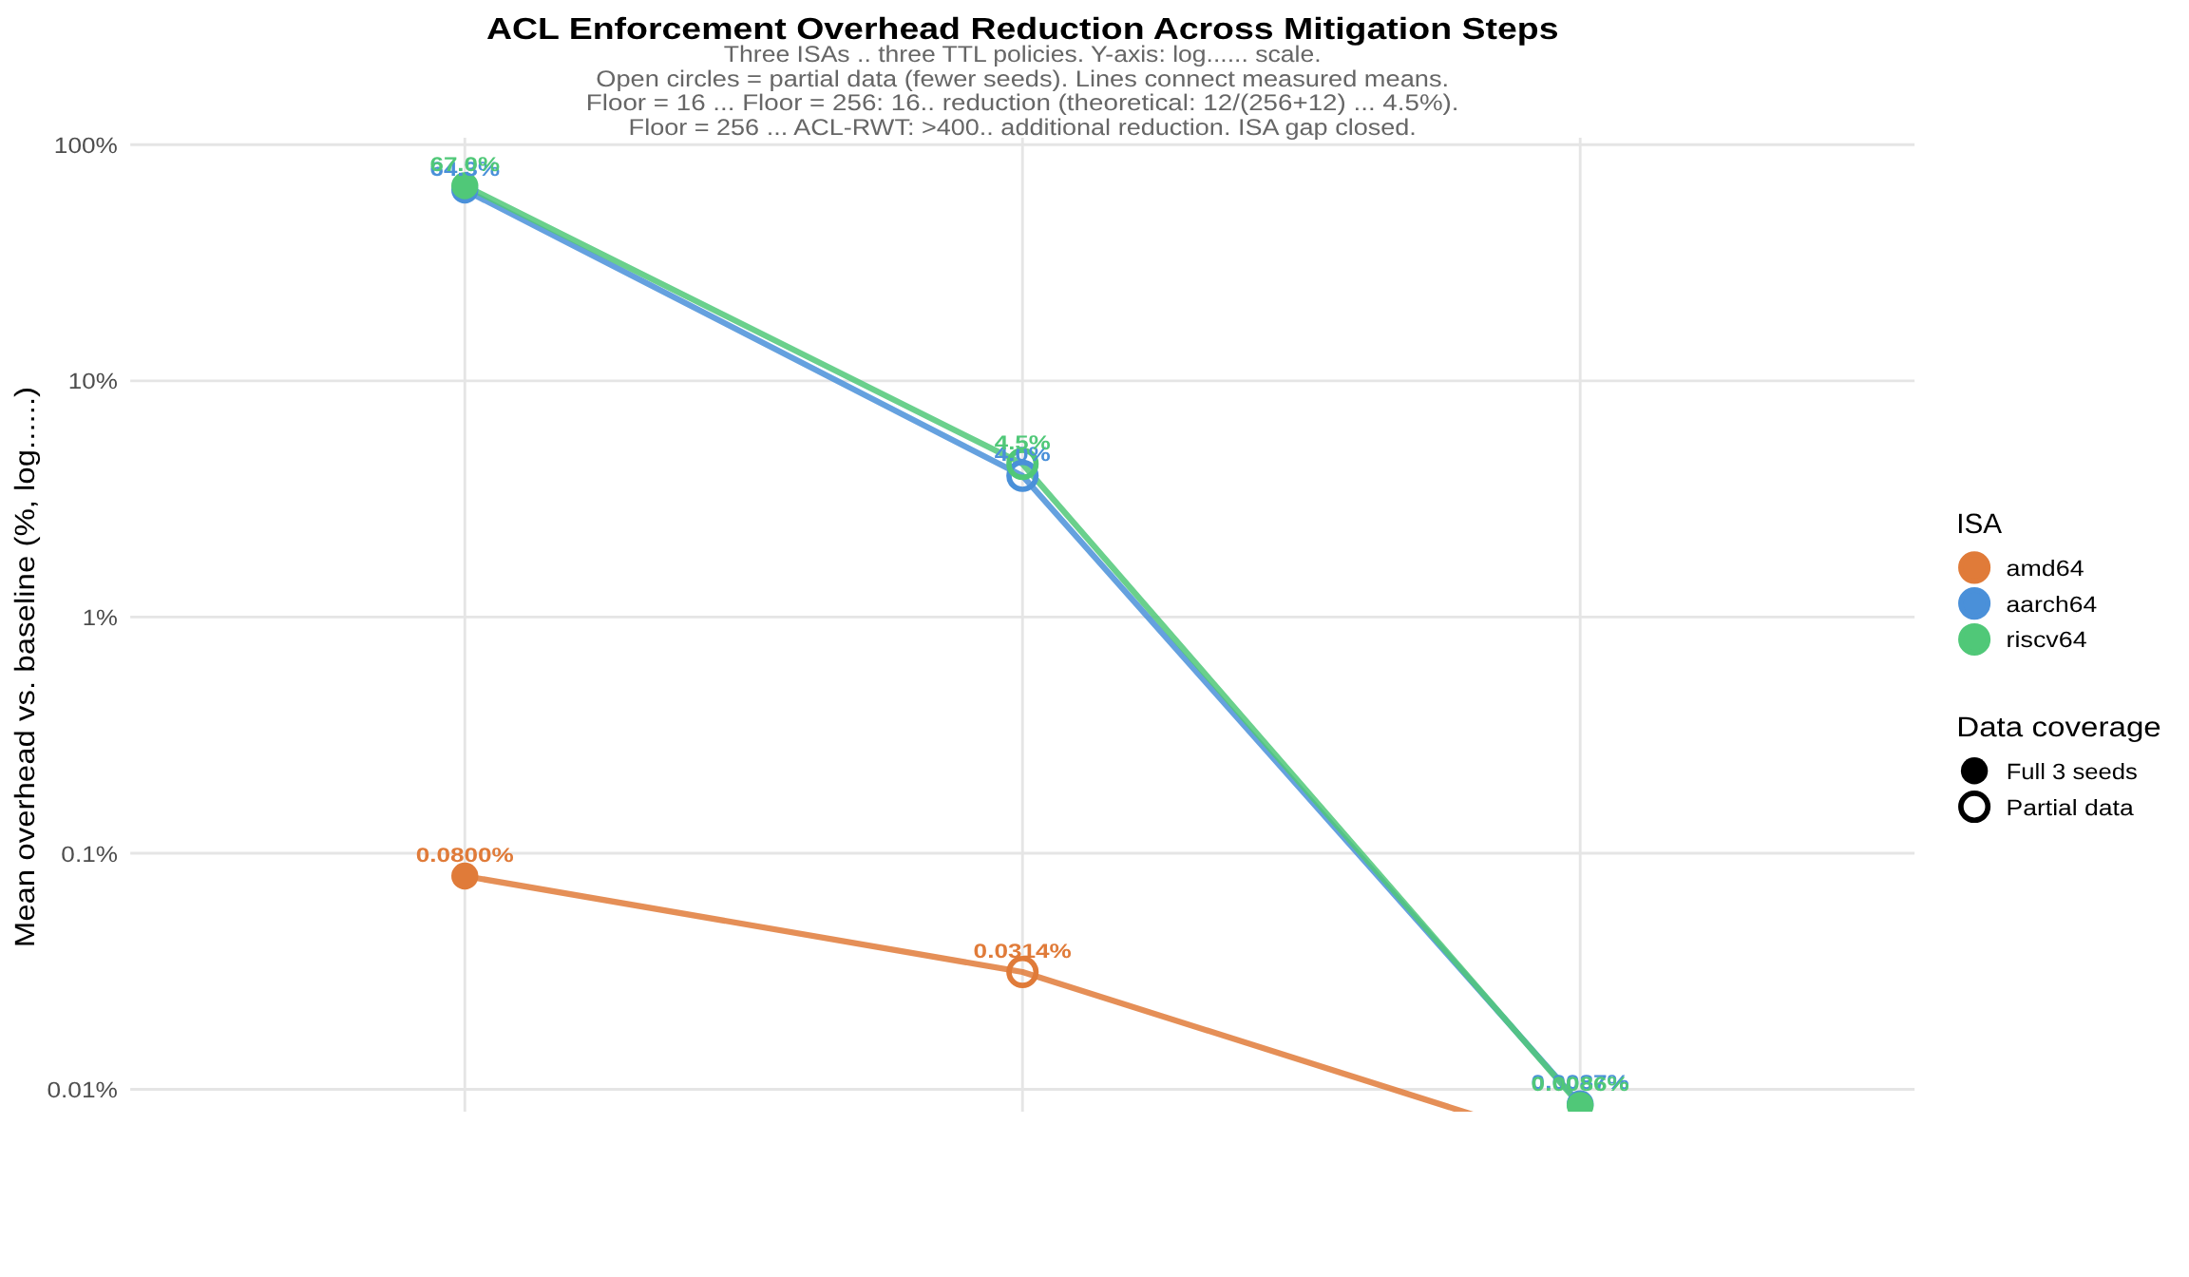
ACL-RWT — THE STRUCTURAL FIX
Same compudynamic feedback topology, applied to TTL itself
ACL Rolling Window of Truth applies the same feedback shape as Loops #2+#3+#6 to the ACL TTL: start every word fully open (MAX-TTL=65535), then infer the right TTL from a per-word 8-entry ring buffer of buffered intervals.
TTL = ⌊ Ī · (256+s) / 256 ⌋, clamped to [256, 65535] — Ī = mean buffered interval, s = Q8 slope
Measured in heartbeat ticks (1 tick = 256 word executions), not wall-clock — architecture-independent by construction.
+0.0054% to +0.0088%
final 3×3 Latin square, all nine cells, CV = 0.000%
StarForth — Technical Deep Dive
25

Slide 27
VI
Cross-ISA DoE
The bare-metal determinism campaign across three CPU architectures
StarForth — Technical Deep Dive
26

Slide 28
CAMPAIGN SETUP
LithosAnanke under QEMU, three architectures
Architecture | Emulation target | Timer
amd64 | OVMF | APIC @ 10µs
aarch64 | Cortex-A57 | Generic Timer
riscv64 | RV64GC | OpenSBI + CLINT
30
2,349,864
3×
replicates × 16-config DoE × 3 architectures = 480 runs/arch
total heartbeat ticks measured, fixed 10,000ns (100kHz) tick
outer-replication Latin square on top of the base campaign
All three architectures use software emulation (accel=tcg) — never run concurrently, to avoid corrupting the timing signal being measured.
StarForth — Technical Deep Dive
27

Slide 29
BASELINE RESULTS
Execution rate is architecture-invariant
Arch | Ticks | Mean exec/tick | Mean σ(exec) | Elapsed
amd64 | 261,098 | 255.98 | 1.107 | 2.611 s
aarch64 | 261,095 | 255.98 | 1.117 | 2.611 s
riscv64 | 261,095 | 255.98 | 1.117 | 2.611 s
Cross-ISA: F₂,₇₈₃₂₈₅ ≈ 0, p = 1.000 · Cross-seed ANOVA: F₂,₆ ≈ 0, p = 1.000 · CV = 0.000%
aarch64 and riscv64 produced byte-for-byte identical CSV output (MD5-matched) on the original 261,095-row run.
“The physics of the FORTH interpreter is a property of the algorithm, not the hardware.”
StarForth — Technical Deep Dive
28

Slide 30
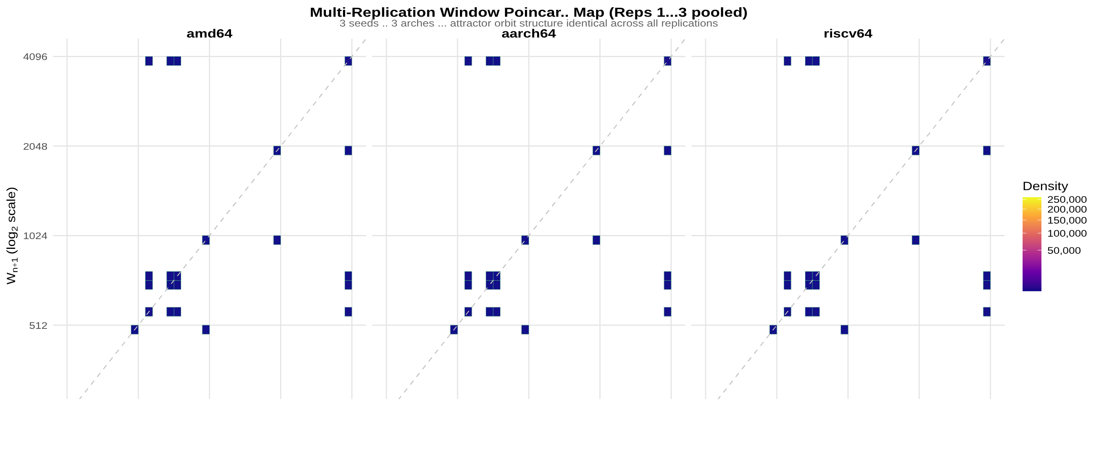
THE COMPUDYNAMIC BREATHING CYCLE
A discrete 5-point limit cycle, not noise
StarForth — Technical Deep Dive
29

Slide 31
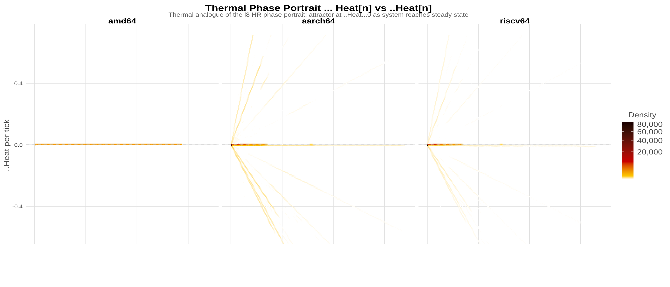
THERMAL PHASE PORTRAIT
Heat h_n vs. Δh_n, all three architectures
StarForth — Technical Deep Dive
30

Slide 32
TIMER-HARDWARE DIVERGENCE
Attractor-neutral — a calibration residual, not a bug
A clean aarch64 re-run diverged from riscv64 in heat columns only (hot_word_count, avg_word_heat_q48) from tick 34,001 onward — while every attractor metric (execution rate, window width, temporal trust, timing variance) stayed identical.
Interpretation: heat carries small run-to-run noise, but the attractor itself does not — the dynamics that matter for the determinism claim are unaffected.
H ∈ {667664, 667777, 667881} across three replications, all p < 2.2×10⁻¹⁶
x86-64 APIC emulation leaves a measurable calibration residual (t̄ = 0.9947, σ̄² = 9.5×10⁻³) that ARMv8's Generic Timer and RISC-V's CLINT don't share — attributed to timer hardware, not the algorithm. amd64 differs by only 3 rows total, from APIC scheduling — no effect on any headline statistic.
StarForth — Technical Deep Dive
31

Slide 33
VII
Verification & Rigor
Isabelle/HOL proofs, negative results, and honest scope
StarForth — Technical Deep Dive
32

Slide 34
FORMAL VERIFICATION
24 Isabelle/HOL theory files
Loop correctness (8)
StarForth_Base, Loop1_Heat … Loop7_Heartrate
Word-category correctness (5)
Arithmetic, Stack, Logical, Memory, Return-Stack Words
System properties (6)
Q48_16, Correctness, Concurrent, Transition, Mutex, +1
ACL invariants (5)
Pin-Monotone, Inherit-Clears-Pin, TTL-Bounded, Emergency-Bypass, No-Escalation
Build: isabelle build -D proof/. Explicit scope caveat, stated by the project itself: full mechanized proof of all 7 feedback loops is not yet complete — partial proofs are in progress.
StarForth — Technical Deep Dive
33

Slide 35
NEGATIVE RESULTS
15 catalogued failure modes, published alongside the successes
Condition | Effect
Random-timer-driven control flow | CV rises to ~15%, no convergence — explicit scope boundary, no mitigation
I/O-bound workloads | ≤2% improvement; net degradation from ~5% overhead
Window size 10 (vs. default 4096) | R² < 0.5, unstable
Decay slope λ=10.0 (vs. ≈0.001) | Cache thrashing
Thermal throttling | Runtime CV > 90%; cache-decision CV stays 0%
32 concurrent CPU-saturating processes | Runtime CV > 150%; cache-decision CV still 0%
The last two rows are the sharpest demonstration of the core claim: even under conditions that make wall-clock timing wildly unstable, the algorithm's own decisions stay exactly at 0% variance.
StarForth — Technical Deep Dive
34

Slide 36
WHAT THIS PROJECT DOES NOT CLAIM
A standing anti-claims table, maintained alongside the results
✕
Not a physical theory — thermodynamic language is an explicit modeling metaphor, not literal physics
✕
Not global optimality — locally adaptive, not provably optimal
✕
Not AI/ML — no neural networks, gradient descent, backpropagation, training data, or reinforcement learning
✕
Not the first adaptive VM, and not claimed to be the fastest or to beat JIT compilers
✕
Not complete formal verification — partial mechanized proofs, stated openly
✕
Not proven causation beyond the tested configurations
✕
Not cross-language validated — FORTH-family interpreters only, so far
✕
Not production-ready, and StarshipOS does not yet exist as a functional system
StarForth — Technical Deep Dive
35

Slide 37
OPEN RESEARCH QUESTIONS
Where the honest debate is
1
Does full mechanized proof coverage for all 7 loops change any of the empirical conclusions, or only formalize them?
2
How far does the validated scope extend into I/O-bound and non-deterministic-control-flow workloads?
3
Does the conservation-law framing (James Law) generalize beyond FORTH-family interpreters to other VM architectures?
4
What is the actual asymptotic behavior of dictionaries beyond ~100,000 entries, where the transition matrix currently grows quadratically?
5
How does the Tripod's capability-based dispatch model scale past three VMs, given IDX>NAME and CH-ACCEPT are currently hardcoded for exactly three?
StarForth — Technical Deep Dive
36

Slide 38
ROADMAP
2025 → 2028
2025
2026
2027
2028
The VM
The Kernel
Self-Hosting OS
Custom Hardware
Done. StarForth v3.1.0, FORTH-79 compliant, 936+ tests.
In progress. LithosAnanke M0–M7, Tripod fleet, ACL Phase 8.
StarshipOS — storage, networking, multitasking, self-compile.
FPGA feasibility study.
StarForth — Technical Deep Dive
37

Slide 39
Let's go deeper.
Formal volumes, DoE reports, Isabelle/HOL proofs, and the full source tree are available for review.
github.com/rajames440/StarForth · rajames440@gmail.com
Robert A. James (“Captain Bob”) · Patent pending — USPTO provisional, December 2025

